Slide 1
SE 3140 : Design and Modelling
SE 3140
DESIGN AND MODELLING
M. Mangong Clement
System Design and Modelling

Slide 2
SE 3140 : Design and Modelling
SE 3140
DESIGN AND MODELLING
By M. Mangong C. Fosah
mangong.clement@ictuniversity.org
(+237) 653 519 879
M. Mangong Clement
System Design and Modelling

Slide 3
ICT 3140 : Design and Modelling
Chapter 1:
Introduction to Software Design and Modelling
Mangong C. Fosah
ICT Univerisity
System Design and Modelling

Slide 4
SE 3140 : Design and Modelling
Chapter 1: Topics Overview
Understanding basic Modelling terms
The importance of Modelling
The Need for Model
Impact of software fault
Assignment
Mangong C. Fosah
ICT Univerisity
System Design and Modelling

Slide 5
SE 3140 : Design and Modelling
Understanding basic terms
What is modelling?
Used in science and engineering to provide abstractions of a system at some level of precision and details.
Chapter One : Introduction to software Design and Modelling

Slide 6
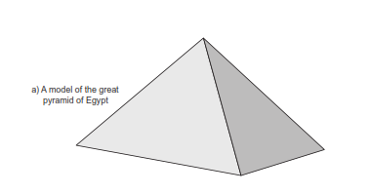
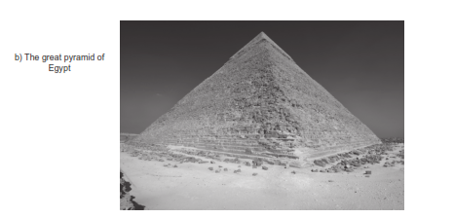
SE 3140 : Design and Modelling
Understanding basic terms Contd…
Modeling
It is used in science and engineering to provide abstractions of a system at some level of precision and details.
Chapter One : Introduction to software Design and Modelling

Slide 7
SE 3140 : Design and Modelling
Understanding basic terms Contd…
Modeling
The model is then analyzed in order to obtain a better understanding of the system being developed.
Chapter One : Introduction to software Design and Modelling

Slide 8
SE 3140 : Design and Modelling
Understanding basic terms Contd…
Why Modelling? (None software example 1)
To architect a dog house
Can be done by one person. It involves a simple process, performed with basic tools.
In few hours you end with a house for dog and can do with no one else’s help.
Modeling effort is minimal or sometimes unnecessary.
Chapter One : Introduction to software Design and Modelling

Slide 9

SE 3140 : Design and Modelling
Understanding basic terms Contd…
Why Modelling? (None software example 2)
If you want to build a house for your family, is it possible?
It requires detailed planning and some sketches etc.
Chapter One : Introduction to software Design and Modelling

Slide 10


SE 3140 : Design and Modelling
Understanding basic terms Contd…
What is software modeling?
Is it expressing a scientific theory or algorithm in software ?
Is it larger than an algorithm or a single method.
Does it address the entire software design including interfaces, interactions with other software, and all the software methods.
Chapter One : Introduction to software Design and Modelling

Slide 11
SE 3140 : Design and Modelling
Understanding basic terms Contd…
What is software modeling?
It is the designing of software application before coding (Object Modeling Group – OMG)
In model-based software design, software modeling is used as an essential part of software development.
Models are built and analyzed before system implementation.
Chapter One : Introduction to software Design and Modelling

Slide 12
SE 3140 : Design and Modelling
Understanding basic terms Contd…
What is software model?
A model is a simplification with a purpose.
It uses a precisely define notation to describe and simplify a complex and interesting structure, phenomenon, or relationship.
Abstractions of the reality.
Abstraction are simplification that ignore irrelevant details, only represent the relevant details.
Chapter One : Introduction to software Design and Modelling
Notes:
Abstraction are simplification that
• They ignore irrelevant details and
• They only represent the relevant details.
What is relevant or irrelevant depends on the purpose of the model.

Slide 13
SE 3140 : Design and Modelling
Understanding basic terms Contd…
What is software model? (1)
Abstractions that allows representation of various layers of complex information regarding a software.
Anything that uses abstraction to capture pieces of a software.
A way of expressing a software design
The models are used to create the software architecture.
Chapter One : Introduction to software Design and Modelling
Notes:
Software modeling addresses the entire software design including interfaces, interactions with other software, and all the software methods. Software models are ways of expressing a software design. For object oriented software, an object modeling language such as UML is used to develop and express the software design. Modeling languages allows the designer to try different designs and decide with will be best for the final solution. One of the benefits of designing your software using a modeling language is that you discover problems early and fix them without refactoring your code.

Slide 14
SE 3140 : Design and Modelling
Understanding basic terms Contd…
What is software model? (2)
These are ways of expressing a software design.
A sort of abstract language or pictures are used to express the software design.
For object-oriented software, an object modeling language such as UML is used to develop and express the software design.
Chapter One : Introduction to software Design and Modelling

Slide 15
SE 3140 : Design and Modelling
Understanding basic terms Contd…
What is software model ? (3)
One of the reasons to start a software by building models is actually built to find out if something will work.
Software model helps developers visualize, communicate and validate a system before significant amounts of money are spent.
This means, verifying and validating the model is very important.
Chapter One : Introduction to software Design and Modelling

Slide 16
SE 3140 : Design and Modelling
Understanding basic terms Contd…
What is software model ? (4)
Unified Modeling Language (UML) is a modeling tool used to build models especially object oriented models.
A modeling language is use to develop the design not just to capture the design after its complete.
Chapter One : Introduction to software Design and Modelling

Slide 17
SE 3140 : Design and Modelling
Understanding basic terms Contd…
Unified Modeling Language (UML)
The UML allows the designer to try different designs and decide which will be best for the final solution.
A standard graphical modeling language that helps to develop, understand and communicate the different views.
Chapter One : Introduction to software Design and Modelling

Slide 18
SE 3140 : Design and Modelling
Understanding basic terms Contd…
Unified Modeling Language (UML) (1)
Just as C++ is the programming language used for implementing your software in programming, so is UML used for building a software design and implemented in a programming language that is object-oriented.
That implies that UML is considered to be an object-oriented modeling language.
Chapter One : Introduction to software Design and Modelling

Slide 19
SE 3140 : Design and Modelling
Understanding basic terms Contd…
Unified Modeling Language (UML)(2)
The UML allows the designer to try different designs and decide which will be best for the final solution.
A standardized graphical notation for describing object-oriented models.
Chapter One : Introduction to software Design and Modelling

Slide 20
SE 3140 : Design and Modelling
Understanding basic terms Contd…
Why UML?
It is methodology-independent
It is a notation for describing the results of an object-oriented and design developed via the methodology of choice.
It need to be used together with an object-oriented analysis and design method.
Chapter One : Introduction to software Design and Modelling

Slide 21
SE 3140 : Design and Modelling
Understanding basic terms Contd…
Why UML?
Permits you to specify the structure or behavior of a system.
Helps you visualize a system.
Provide template that guides you in constructing a system.
Helps to understand complex system part by part.
Document the decisions that you have made.
Chapter One : Introduction to software Design and Modelling

Slide 22
SE 3140 : Design and Modelling
Understanding basic terms Contd…
UML Tools
It is controlled by the Object Management group (OMG)
Version 1.x
Version 2.x most UML tools support this version for its has stronger semantics
Chapter One : Introduction to software Design and Modelling

Slide 23
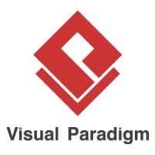


SE 3140 : Design and Modelling
Understanding basic terms Contd…
UML Tools
There are several tools that you can use to develop your UML design.
Examples
Umbrello
Chapter One : Introduction to software Design and Modelling

Slide 24
SE 3140 : Design and Modelling
Understanding basic terms Contd…
UML Tools
Provides three basic types of models
Use case models ( Requirement oriented models)
Static models ( complementary set of design models)
Dynamic models
The three models represents different viewpoints of the model.
Chapter One : Introduction to software Design and Modelling

Slide 25
SE 3140 : Design and Modelling
Understanding basic terms Contd…
UML Tools
Use case Models
Captures the requirement of a system
Captures outside view of a system
Identify the external and internal factors influencing the system
Show the interaction among the requirements
It is the overall big picture of the requirements and what the system has to do.
Chapter One : Introduction to software Design and Modelling

Slide 26
SE 3140 : Design and Modelling
Understanding basic terms Contd…
UML Tools
Static Models
It tells us what information we have in the system and what a sub-system needs to know about another sub-system. Captures basic structure and static elements such as:
• what type of classes do we have in the system
• what information do we have in the classes
• what do the classes need to know about each other etc.
Chapter One : Introduction to software Design and Modelling

Slide 27
SE 3140 : Design and Modelling
Understanding basic terms Contd…
UML Tools
Dynamic Models
It tells us how things work in response to generating events coming into the system.
– Captures behavioral elements (how the system works). It will use the classes defined in the static models to create instances of those classes called object.
– It will show how the objects will communicate
back and forth to satisfy the use cases
Chapter One : Introduction to software Design and Modelling

Slide 28
SE 3140 : Design and Modelling
Understanding basic terms Contd…
Basic characteristics of software models
Simplification
Models of software are far less complex;
More accessible than the actual code and components that makes up the final system.
It’s easier for a developer to work to built, extern and evaluate a visual model than to work directly in the code.
Chapter One : Introduction to software Design and Modelling

Slide 29
SE 3140 : Design and Modelling
Understanding basic terms Contd…
Basic characteristics of software models
Simplification(1)
When decisions are made in code, they turn to stay made but if made at the level of the model, the code can easily be maintain.
With modeling, and especially with a visual modeling tool, decisions can be made and revised quickly and efficiently.
Chapter One : Introduction to software Design and Modelling
Notes:
When decisions are made in code, they turn to stay made but if made at the level of the model, the code can easily be maintain.
- With modeling, and especially with a visual modeling tool, decisions can be made and revised quickly and efficiently.

Slide 30
SE 3140 : Design and Modelling
Understanding basic terms Contd…
Basic characteristics of software models(1)
Varying perspective
A single model of a software system can describe the system form different perspectives.
One view may show how major parts of the system interact and corporate.
Other views might zoom in a particular subsystem part.
Chapter One : Introduction to software Design and Modelling
Notes:
A single model of a software system can describe the system form different perspectives. One view may show how major parts of the system interact and corporate. Other views might zoom in a particular subsystem part. Having all the helps the developer manages complexity, as high level views provide context and navigation. This concept is use in maps, to zoom in and get the details.

Slide 31
SE 3140 : Design and Modelling
Understanding basic terms Contd…
Basic characteristics of software models(2)
Common notation
A precise software model in a common notation allows developers to combine their efforts to work in parallel.
As long as each contribution fits the model, the parts can be combined into the final system.
Modern manufacturing uses this technique to reduce cost of software production schedule.
Chapter One : Introduction to software Design and Modelling

Slide 32
SE 3140 : Design and Modelling
Understanding basic terms Contd…
Principles of UML modeling
1. The choice of model is important.
2. Every model may be expressed at different levels of precision.
3. The best models are connected to reality.
4. No single model is sufficient.
Chapter One : Introduction to software Design and Modelling

Slide 33
SE 3140 : Design and Modelling
Understanding basic terms Contd…
What is software architecture?
It is the overall structure of software system in terms of components and connections.
It captures the components and the connections of the software.
The components and connections helps to enforce design decisions that are made at the lower level.
Chapter One : Introduction to software Design and Modelling

Slide 34
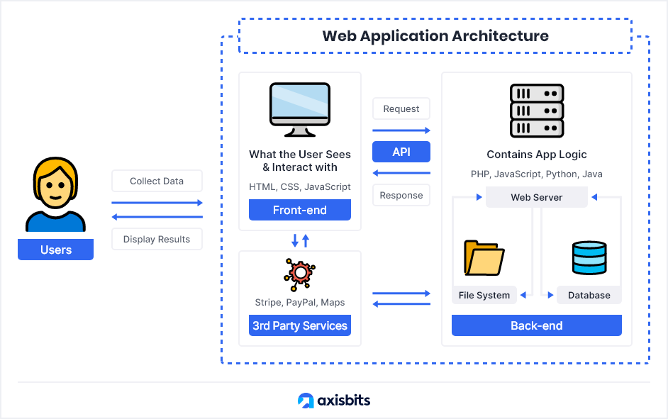
SE 3140 : Design and Modelling
Understanding basic terms Contd…
What is software architecture?
Example: 1
Chapter One : Introduction to software Design and Modelling

Slide 35
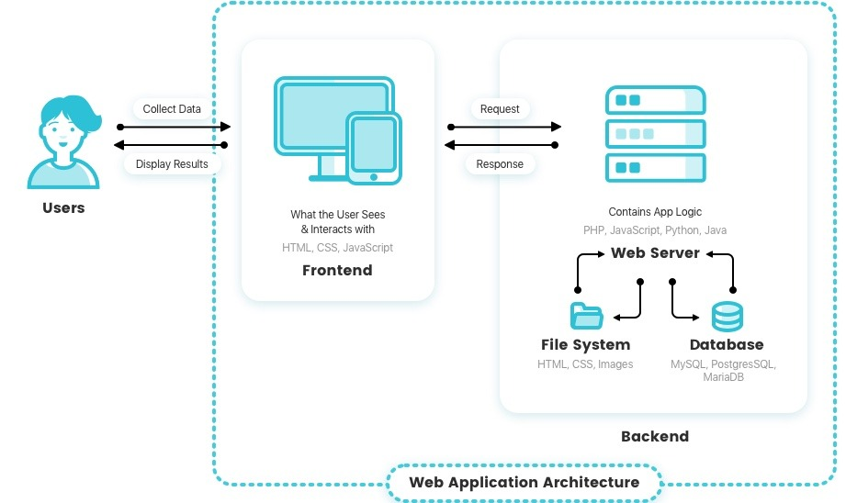
SE 3140 : Design and Modelling
Understanding basic terms Contd…
What is software architecture?
Example 2:
Chapter One : Introduction to software Design and Modelling

Slide 36
SE 3140 : Design and Modelling
Understanding basic terms Contd…
What is software design?
Think of designing your software as you would a house.
You start by drawing a rough sketch of the floor plan and layout of the rooms and floors.
The drawing is your modeling language and the resulting blueprint will be a model of the final design.
You will continue to modify the design until it arrive at a design that meets all your requirements.
Chapter One : Introduction to software Design and Modelling

Slide 37
SE 3140 : Design and Modelling
Understanding basic terms Contd…
What is software design?
Activities involved in conceptualizing , framing , implementing, commissioning, and ultimately modifying complex systems.
Activities following requirements specification and before programming.
Describes the overall architecture and blueprint of software to be constructed.
Chapter One : Introduction to software Design and Modelling

Slide 38
SE 3140 : Design and Modelling
Understanding basic terms Contd…
What is software design?
One of the benefit for designing your software using modeling language is that you discover problems early and fix them without refactoring your code.
Chapter One : Introduction to software Design and Modelling

Slide 39
SE 3140 : Design and Modelling
Understanding basic terms Contd…
What is software design?
An important component of software design is software requirement analysis(SRA – list specification used)
Two forms of software design
1. Process
Sequence of steps that enables designer to describe all aspects of the software for building
2. Model
blueprint of software to be constructed (usually what is
given to developers to write the code)
Chapter One : Introduction to software Design and Modelling

Slide 40
SE 3140 : Design and Modelling
Understanding basic terms Contd…
What is a Software Process?
How do you know when to create/design software?
Activities for designing, implementing, and testing a software system
It is a lifecycle approach to development.
It tells us the kind flow of activities in the software development. Is it waterfall, iterative etc.?
Chapter One : Introduction to software Design and Modelling

Slide 41
SE 3140 : Design and Modelling
Understanding basic terms Contd…
What is a Software Process?
Representation of the order of activities of the process and the sequence in which they are performed.
To provide guidance for controlling and coordinating the tasks to achieve the end product and objectives as effectively as possible.
It helps us to organize our project.
Lifecycle process controls the flow of activities.
Chapter One : Introduction to software Design and Modelling

Slide 42
SE 3140 : Design and Modelling
Understanding basic terms Contd…
What is a Software Design Method?
This is usually documented in a software document plan (SDP) before starting a software development project.
The combination of the lifecycle process model with design/modeling guidelines for clear guidance on which artifacts(object made by human) should be produced.
Chapter One : Introduction to software Design and Modelling

Slide 43
SE 3140 : Design and Modelling
Why is modeling necessary
Why don’t we consider some basic requirements and then go straight to programming?
Programming with the basic requirements is no longer feasible for most application.
• Software size is increasing exponentially.
Chapter One : Introduction to software Design and Modelling

Slide 44
SE 3140 : Design and Modelling
Why is modeling necessary
Most problems with software systems occur when different pieces have to interact.
• Still a poorly understood problem
• Problems are often discovered late with great cost.
• Often leads to performance issues too
Chapter One : Introduction to software Design and Modelling

Slide 45
SE 3140 : Design and Modelling
The Need for Models
A model is an abstraction, representing varying layers and views of complex information.
Standard practice in nearly every engineering discipline.
• Model helps us
Organize
Communicate
Reason
Analyze our system.
Chapter One : Introduction to software Design and Modelling

Slide 46
SE 3140 : Design and Modelling
The Need for Models(1)
We use models to develop large scale systems, organize them into manageable pieces and to communicate what we are building to our customers.
With the models, we will reason and analyze the systems we are building before we begin writing a line of code.
Chapter One : Introduction to software Design and Modelling

Slide 47
SE 3140 : Design and Modelling
The Need for Models(2)
We could analyze how the system will work by simulating the execution before writing the code.
We can see the performance characteristics to get out of the system.
It is easier and cheaper to fix errors in software design level models than to fix things when coding.
Chapter One : Introduction to software Design and Modelling

Slide 48
SE 3140 : Design and Modelling
The Need for Models(3)
Software models are ways of expressing a software design while software modeling expressing the entire software design including interfaces, interactions with other software, and all the software methods.
Chapter One : Introduction to software Design and Modelling

Slide 49
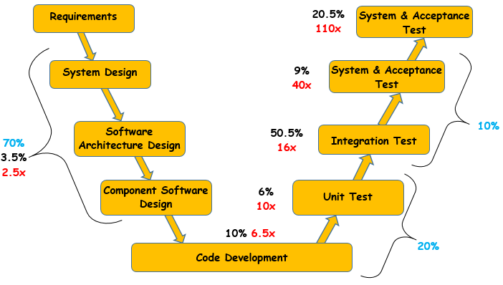
SE 3140 : Design and Modelling
Impact of software fault
Key:
Where faults are introduced
Where faults are found
Estimated cost factor for fault removal
Chapter One : Introduction to software Design and Modelling

Slide 50
SE 3140 : Design and Modelling
Impact of software fault
Basically the model is the primary software engineering artifact at this point.
Model-based software engineering approaches provide a consistent, unified model supporting analysis from the earliest stages of the software engineering lifecycle.
Chapter One : Introduction to software Design and Modelling

Slide 51
SE 3140 : Design and Modelling
Impact of Software fault
Basically the model is the primary software engineering artifact at this point.
Model-based software engineering approaches provide a consistent, unified model supporting analysis from the earliest stages of the software engineering lifecycle.
Chapter One : Introduction to software Design and Modelling

Slide 52

ICT 2220
QUESTIONS
Objet Oriented, Analysis, Design and implementation

Slide 53
SE 3140 : Design and Modelling
Class Evaluation
Groups (7 members)
Creating of groups
Use of Trello and Slack ( creation and Usage)
Attendance recording (daily and weekly)
UML software : StarUML
M. Mangong Clement
System Design and Modelling

